Slide 1
PDS
SDN
NFV
Computer Vision
Konfigurasi WebServer on Ubuntu Server
Lab 2
https://github.com/siagianp
https://www.youtube.com/@AmelOline/videos
https://github.com/amelcharolinesgn2/IoT_simulator-mqtt-NodeRed
https://github.com/amelcharolinesgn2/Cloud-Infrastructures
https://github.com/amelcharolinesgn2/ClouD-Infrastructure-SISKA-2025
Notes:
https://www.pintar-network.com/2018/05/konfigurasi-nat-router-mikrotik.html
https://gerakanopensource.wordpress.com/2016/01/03/konfigurasi-router-mikrotik-interface-ip-address-ip-route-ip-dns-ip-dhcp-server-ip-firewall-nat-ip-firewall-mangle-hotspot-server-radius-server-manajemen-bandwidth-queue-tree/

Slide 2
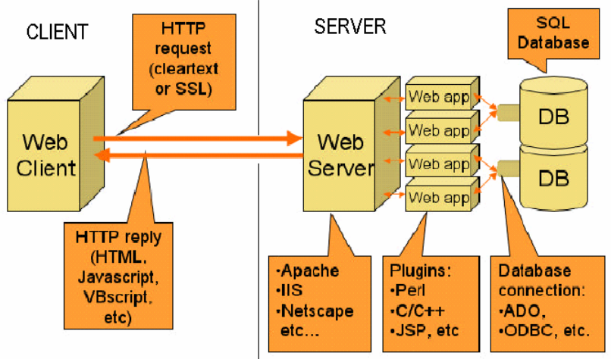
Webserver
Komponen Sistem

Slide 3
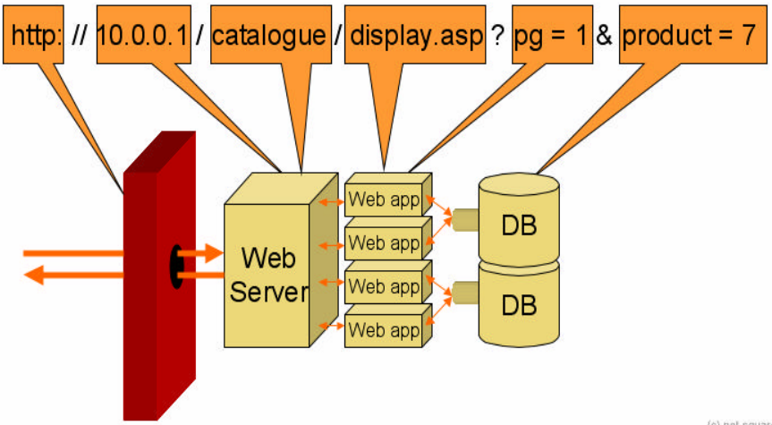
Mapping URL Sistem Web

Slide 4
Webserver

Slide 5
Webserver

Slide 6
Webserver

Slide 7
Webserver

Slide 8
Webserver

Slide 9
Webserver

Slide 10
Webserver

Slide 11
Webserver

Slide 12
Webserver

Slide 13
Webserver

Slide 14
Webserver

Slide 15
PDS
SDN
NFV
Computer Vision
Thank You !!
https://github.com/siagianp
https://www.youtube.com/@AmelOline/videos
https://github.com/amelcharolinesgn2/IoT_simulator-mqtt-NodeRed
https://github.com/amelcharolinesgn2/Cloud-Infrastructures
https://github.com/amelcharolinesgn2/ClouD-Infrastructure-SISKA-2025

Slide 16
Referensi webserver
https://antfornation.medium.com/instalasi-dan-konfigurasi-web-server-dan-dns-server-pada-ubuntu-server-ca0d6148da13
https://www.layerstack.com/resources/tutorials/How-to-restart-Network-Interface-or-Network-Adapter-on-Linux-and-Windows-Cloud-Servers#:~:text=You%20may%20need%20to%20restart%20the%20server,made%20to%20the%20network:%20*%20**netplan%20apply**

